Slide 1

Grade Calculator
Edward Mack & Will Judkins

Slide 2
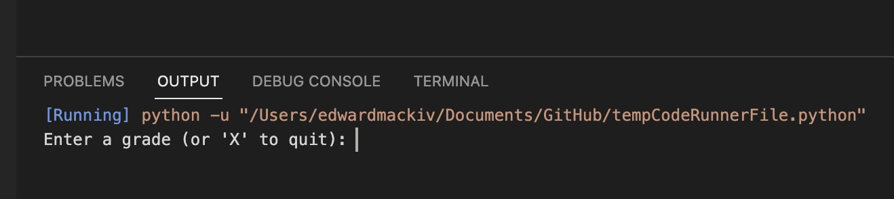
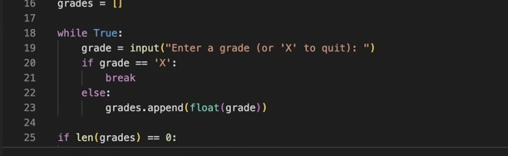
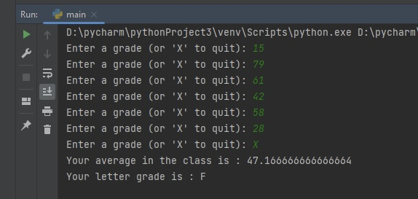
Grade calculator software is created to easily calculate one’s grade for a class. It will prompt students to entire grade scores then once ready to see the average will output a numeric average alongside a letter grade
First stage in output requires user input. Asking user for numeric input of grades.
Placing the user input inside a “while true” loop allows it to run without breaking until user’s choice to quit.
After the user put all the grades code output should promptly show grades inserted and then the averaged and letter grade for their class.

